Slide 1

GLS & LME
Lecture 6
LSM3257
AY22/23; Sem 2 | Ian Z.W. Chan

Slide 2
Summary (Learning Objectives)
Generalised Least Squares (GLS)
- Purpose
- Types of variance structures: varIdent, varFixed, varPower, varExp, varConstPower, varComb
- Fitting, checking and comparing
Linear Mixed Effect (LME) models
- Random effects: what are they, why and when to use them?
- lmer() vs. lme()
- Fitting, checking and comparing
- Simplifying: random effects using REML, then fixed effects using ML

Slide 3
Advanced analyses – Analysis decision tree
(will be modified further)
Normally distributed (errors):
Regression*
Not normally distributed (errors):
Generalised Linear Model (GLM) with error structure to be determined by you
Start
All Continuous
Response variable type
Continuous
Explanatory variables types
All Categorical
Normally distributed (response):
Analysis of variance (ANOVA)*
Not normally distributed (response):
Kruskal-Wallis test
Categorical
Continuous and Categorical
Time to Death
Count
Number of categories
Normally distributed (response):
Analysis of covariance (ANCOVA)*
Not normally distributed (response):
Rank-based ANCOVA (RANCOVA) or
GLM with error structure to be determined by you
Proportion
2
>2
GLM with Poisson errors (aka Poisson regression)
No
*Heteroscedasticity: use GLS
Overdispersion present?
GLM with Binomial errors (aka Binary Logistic regression)
Yes
Survival Analysis
GLM with Binomial errors (aka Logistic regression)
GLM with Quasi-Poisson errors or
GLM with Negative Binomial errors
GLM with Multinomial errors (aka Multinomial Logistic regression)

Slide 4
GLS
Generalised Least Squares

Slide 5
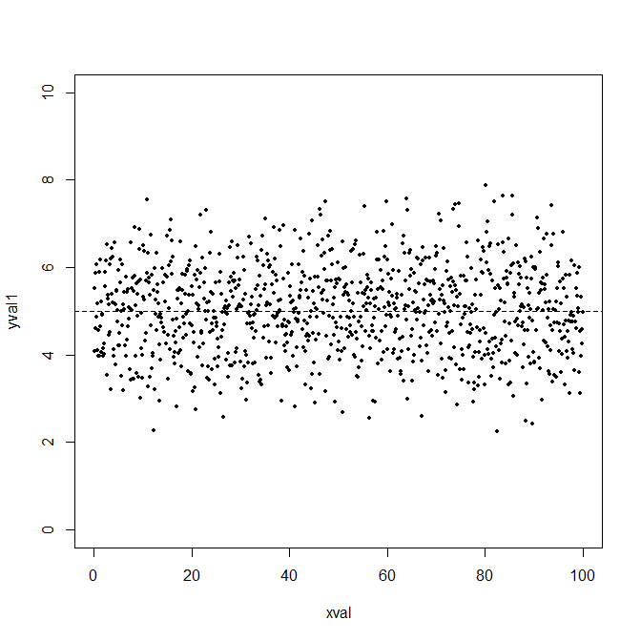
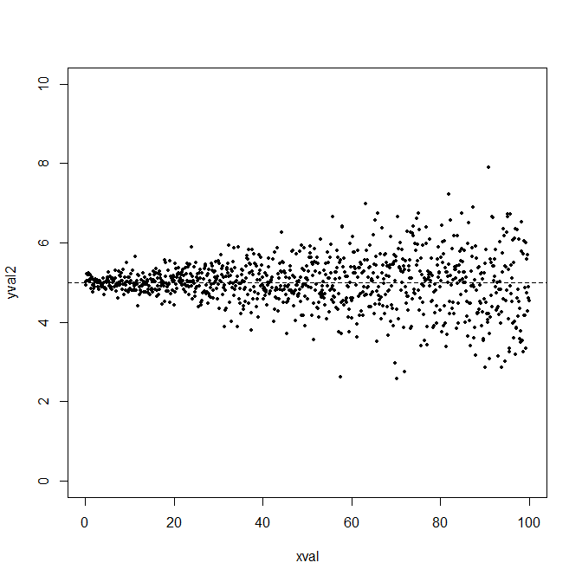
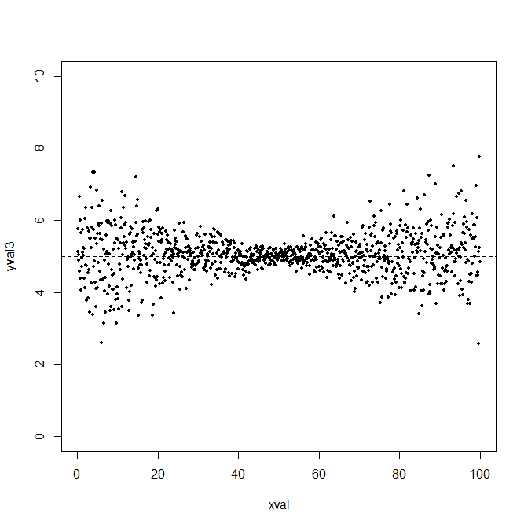
What is GLS?
Used if:
i) You’re doing a linear model (i.e. a Regression, ANOVA or ANCOVA; you have one continuous response variable and one or more continuous or categorical response variables); and
ii) Your model has a problem with heteroscedasticity: because variance changes with the values of a variable, R does not know how to pick the best model.
With GLS, you specify a variance structure (how the variance in the explanatory variable changes) and R will take this into account to fit the best model.
Recall from previous lectures:
R fits the most likely model based on assumptions about: (i) the distribution of the errors and (ii) the variance in the dataset.
Homoscedasticity
Heteroscedasticity

Slide 6
What is GLS?
Types of variance structures you can fit…
Levels of variance (varIdent): variance changes with the levels of a categorical variable.
Fixed variance (varFixed): variance changes with the value of a continuous covariate (x-variable. Do not use if the covariate has negative values.
Power (varPower): variance changes with the power (e.g. xª) of the covariate. Do not use if the covariate has 0 values.
Constant+Power (varConstPower): variance changes with the power of the covariate plus a certain constant. Better than varPower if the covariate has values close to 0.
Exponential (varExp): variance changes with the exponent (e.g. a^{x}) of the covariate. Use this if the covariate has 0 values.
Combination (varComb): used to combine any of the relationships above.
R uses a few parameters (e.g. a) in the above. When you run the GLS, the computer will choose the best value based on maximum likelihood.

Slide 7
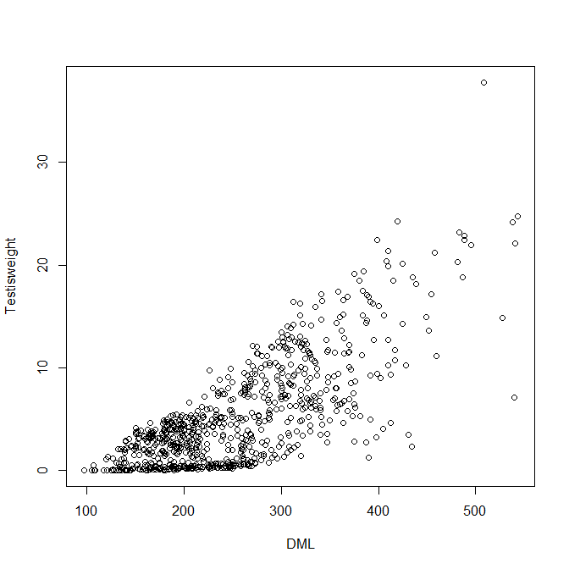
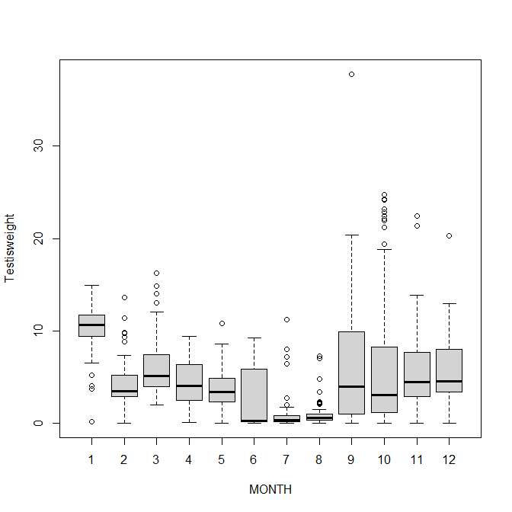
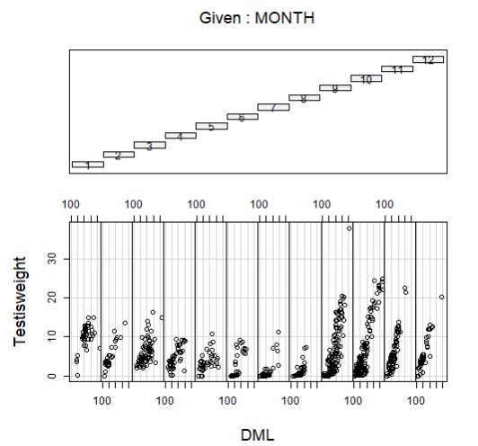
Finding variance structure problems in the dataset
We’re using the Squid dataset from Zuur et al. (2009) where they use <MONTH> (categorical) and <DML> (Dorsal Mantle Length; continuous) to explain <Testisweight> (continuous): therefore an ANCOVA.
#Read in and visualise the dataset
d1=read.table("Squid.txt",header=T)
This coplot() is another useful plot to look for interactions between variables
Notice how the spread increases with DML
Notice how the spread is different for different months
plot(Testisweight~DML,data=d1)
boxplot(Testisweight~MONTH,data=d1)
coplot(Testisweight~DML|MONTH,data=d1,row=1)

Slide 8
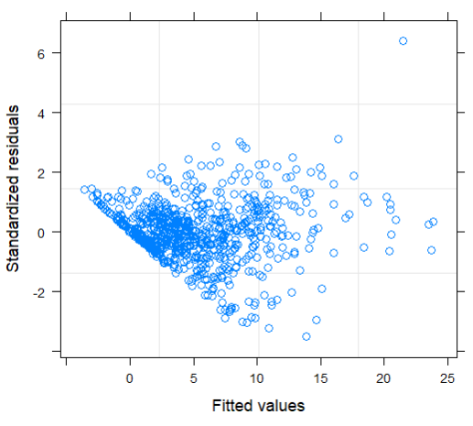
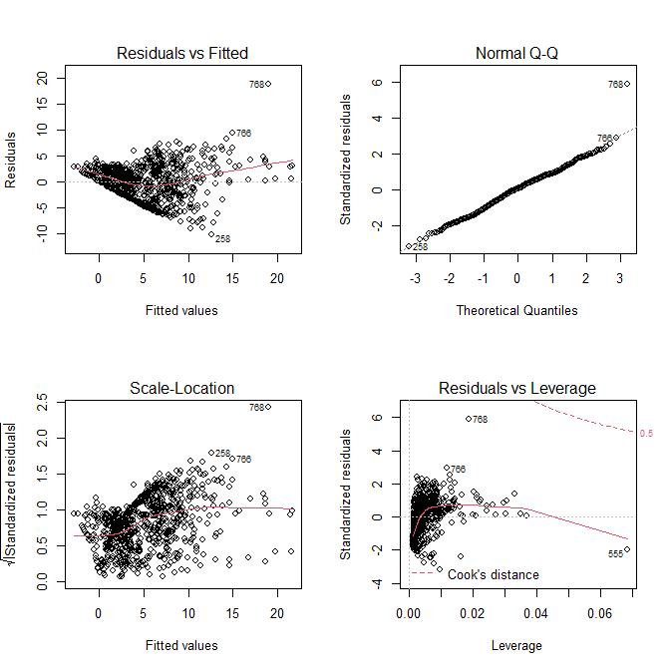
Finding variance structure problems in the dataset
plot(mod.lm)
Both show the same heteroscedasticity
#Install the nlme package to do a GLS
require(nlme)
#Fit the ANCOVA and check the model
mod.lm=gls(Testisweight~DML*MONTH,data=d1)
plot(mod.lm)
mod.lm2=lm(Testisweight~DML*MONTH,data=d1)
par(mfrow=c(2,2))
plot(mod.lm2)
#Looks like problems with heteroscedasticity that changes with DML and MONTH
plot(mod.lm2)
Without any “weights” specified, this is equivalent to a linear model, i.e. an ANCOVA (here) or ANOVA or regression
We could try transforming the variable, but we suspect (from the graphs) that variance is changing with the explanatory variables, so we decide to try fitting a GLS to solve the issue.

Slide 9
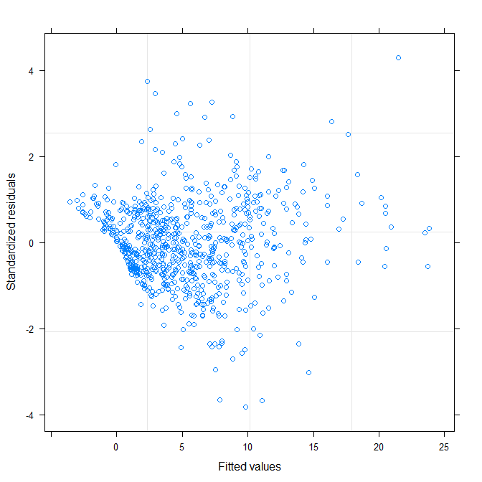
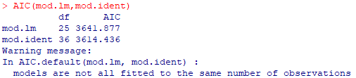
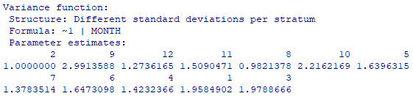
Fitting a GLS
#Specify variance structure for different levels of <MONTH> (categorical variable)
vs1=varIdent(form=~1|MONTH)
#Fit the GLS
mod.ident=gls(Testisweight~DML*MONTH,data=d1,weights=vs1)
#Compare the two models
AIC(mod.lm,mod.ident)
#Check results
summary(mod.ident)
plot(mod.ident)
The plot suggests there is still more variance structure to account for.
This “weights” command makes this a GLS and tells R how to account for the heteroscedasticity.
This is the format for specifying a categorical variable
AIC for mod.Ident is lower so it is better!
These numbers compare the variance of each month to month 1 (in the boxplots, month 9 is the biggest).

Slide 10
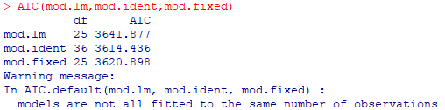
Fitting a GLS
#Specify variance structure for <DML> (continuous variable)
vs2=varFixed(~DML)
#Fit the GLS
mod.fixed=gls(Testisweight~DML*MONTH,data=d1,weights=vs2)
#Compare the models
AIC(mod.lm,mod.ident,mod.fixed)
#mod.ident is still the best so far
If we’re using varFixed, we don’t need the “form=“ and the vertical bar (note: varFixed cannot take categorical variables).

Slide 11
Fitting a GLS
#Specify power variance structure for <DML>
vs3a=varPower(form=~DML)
#Specify power variance structure and also allow it to vary with <MONTH>
vs3b=varPower(form=~DML|MONTH)
#Do the same for constant+power and exponential variance structures for <DML>
vs4a=varConstPower(form=~DML)
vs4b=varConstPower(form=~DML|MONTH)
vs5a=varExp(form=~DML)
vs5b=varExp(form=~DML|MONTH)
The left side of the bar usually specifies the slope of a linear equation, and is for continuous variables.
The right side of the bar usually specifies the intercept of a linear equation and is for categorical variables.
Together, this code allows the effect of DML to be different in different months: we’re accounting for both a categorical variable and a continuous variable at the same time

Slide 12
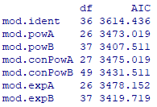
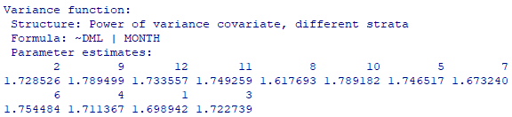
Fitting a GLS
#Fit all the models and compare
mod.powA=gls(Testisweight~DML*MONTH,data=d1,weights=vs3a)
mod.powB=gls(Testisweight~DML*MONTH,data=d1,weights=vs3b)
mod.conPowA=gls(Testisweight~DML*MONTH,data=d1,weights=vs4a)
mod.conPowB=gls(Testisweight~DML*MONTH,data=d1,weights=vs4b)
mod.expA=gls(Testisweight~DML*MONTH,data=d1,weights=vs5a)
mod.expB=gls(Testisweight~DML*MONTH,data=d1,weights=vs5b)
AIC(mod.ident,mod.powA,mod.powB,mod.conPowA,mod.conPowB,mod.expA,mod.expB)
#Check what mod.powB is doing
summary(mod.powB)
mod.powB looks the best
These are the powers applied to <DML> for each month (e.g. in month 2, the variance is a factor of DML^{1.72}).

Slide 13

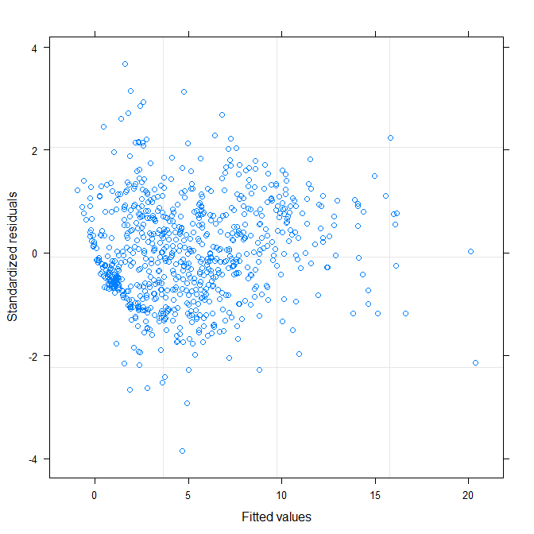
Fitting a GLS
#Combining the various functions
vs6=varComb(varFixed(~DML),varExp(form=~DML|MONTH))
mod.combi=gls(Testisweight~DML*MONTH,data=d1,weights=vs6)
AIC(mod.powB,mod.combi)
#Check mod.powB
plot(mod.powB)
#Now proceed with model simplification and comparison using AIC()
summary(mod.powB)
#A little harder to read but the information is there, including coefficients and p-values
First structure
Second structure
Looks much nicer now!

Slide 14
What if GLS doesn’t solve my heteroscedasticity problems
Your original normal error distribution assumption may be fatally flawed: therefore do a Generalised LM (GLM; in later lectures)

Slide 15
LME
Linear Mixed Effect models

Slide 16
Advanced analyses – Analysis decision tree
(will be modified further)
Normally distributed (errors):
Regression*
Not normally distributed (errors):
Generalised Linear Model (GLM) with error structure to be determined by you
Start
All Continuous
Response variable type
Continuous
Explanatory variables types
All Categorical
Normally distributed (response):
Analysis of variance (ANOVA)*
Not normally distributed (response):
Kruskal-Wallis test
Categorical
Continuous and Categorical
Time to Death
Count
Number of categories
Normally distributed (response):
Analysis of covariance (ANCOVA)*
Not normally distributed (response):
Rank-based ANCOVA (RANCOVA) or
GLM with error structure to be determined by you
Proportion
2
>2
GLM with Poisson errors (aka Poisson regression)
No
*Random effects: use LME
Overdispersion present?
GLM with Binomial errors (aka Binary Logistic regression)
Yes
Survival Analysis
GLM with Binomial errors (aka Logistic regression)
GLM with Quasi-Poisson errors or
GLM with Negative Binomial errors
GLM with Multinomial errors (aka Multinomial Logistic regression)

Slide 17
What are Random Effects?
“Random effects” are NOT RANDOM.
So far when we fit a(n) regression/ANOVA/ANCOVA, we partition the variation to:
1) the variables we are interested in (the main explanatory variables aka Fixed effects).
2) the residuals (Errors due to random chance).
Additionally, an LME allows us to partition the variation to:
3) variables which we expect to have an effect but which we are not interested in for this particular experiment/research question (the Random effects).
- A particular variable can be a Fixed effect in one experiment and a Random effect in another—it all depends on your research question.
Random effects can be categorical (“random intercept”) or continuous (“random slope”).

Slide 18

Examples of Random Effects
Experiment 1: I measure the effect of shore substrate (Rocky vs. Sandy) on the number of crabs at 10 different beaches.
Response variable: number of crabs.
Explanatory variable (Fixed effect): substrate.
Random effect: 10 beaches.
Experiment 2: I measure the effect of the location of 10 beaches on the number of crabs at the beach, and control for the effects of shore substrate.
Response variable: number of crabs.
Explanatory variable: 10 different beaches.
Random effect: substrate (but not ideal because < 5 levels).
Beach 1
R
S
Beach 9
Beach 10
Beach 2
Beach 4
Beach 7
Beach 8
Beach 3
Beach 5
Beach 6

Slide 19
Examples of Random Effects
Experiment 3: I use the number of people living near a protected area to explain the success of the protected area in 10 different countries with varying GDP.
Response variable: success of protected area.
Explanatory variable: number of people living near the protected area.
Random effects: country and GDP.
Experiment 4: I test the effects of butterfly colour (brown and black) and light levels (dim and bright) on mantid attack rates using 25 different mantids.
Response variable: attack rate.
Explanatory variables: butterfly colour and light level.
Random effects: 25 mantids.
Answer
Answer
Answer
Answer

Slide 20
Why include Random Effects?
Accounting for the variation caused by these effects will produce a better model of our fixed effects: more realistic (a better approximation of what is happening in reality) and more powerful (better able to find a true effect).
Random effects are estimated differently from fixed effects (Linear unbiased prediction instead of Maximum Likelihood): fewer parameters are estimated, multiple comparisons are avoided and precious Degrees of Freedom are saved.
- Random effects are important variables that are NOT your research question.
- In general, you want categorical random effects to have at least 5 levels (if the variable has < 5 levels, it is probably better to include it as a fixed effect).
Why include them as Random effects?
2 Guidelines for using random effects

Slide 21
Fitting Linear Mixed Effect models – linear models with random effects
Two functions from two different packages:
1) lme4 package, lmer() function.
Pros: Can have multiple independent random effects. Faster.
Cons: Cannot specify variance structure. Does not give p-values by default, need to install the lmerTest package as well.
#Example code: mod.lme=lmer(y~x1+x2*x3/x4+(1|A/B/C)+(E|D))
2) nlme package, lme() function.
Pros: You can also specify variance structure using “weights=” like a GLS.
Cons: Cannot have multiple random intercepts (except if they are nested).
#Example code: mod.lme=lme(y~x1+x2*x3/x4,random=~1|A/B/C)
Adding a second random effect with a random slope “E”
Fixed effects. Can include interactions and nestedness as we have previous learnt
Random effects for variables A, B and C specified like this. C is nested in B is nested in A (e.g. C is leaves, B is trees, A is forest)

Slide 22
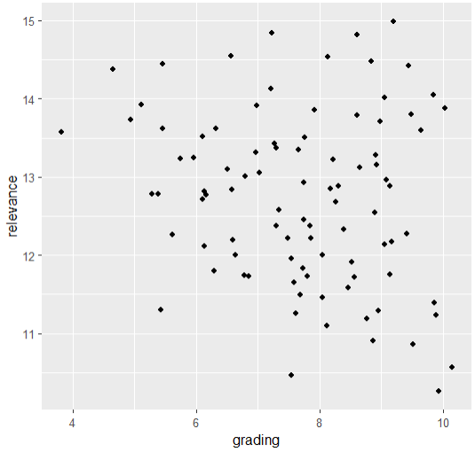
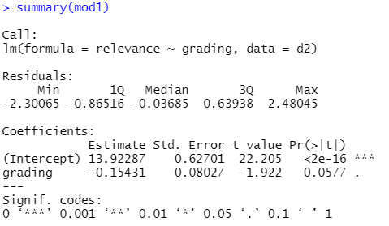
Fitting LMEs
#Prepare the dataset
d2=read_excel("relevance.xlsx")
d2$origin=as.factor(d2$origin)
d2$process=as.factor(d2$process)
library(ggplot2)
ggplot(data=d2,aes(x=grading,y=relevance))+
geom_point()
#Explain <relevance> using <grading>:
#Normal regression
mod1=lm(relevance~grading,data=d2)
summary(mod1)
Without random effects, the effect of <grading> is marginal

Slide 23
Fitting LMEs – 1 random effect (categorical)
lme4 package
require(lme4)
require(lmerTest) #for p-values
Maybe <origin> will help to explain:
#1 categorical random effect
mod2a=lmer(relevance~grading+ (1|origin),data=d2)
nlme package
require(nlme)
#1 categorical random effect
mod2b=lme(relevance~grading, random=~1|origin,data=d2)
<origin> is now included as a random effect in the model. Note where it is inserted because it is a categorical variable.

Slide 24
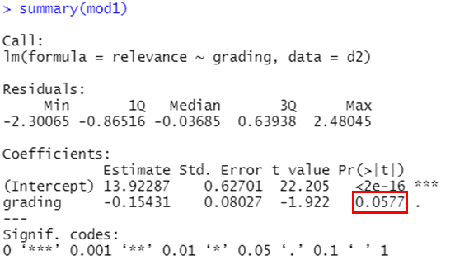
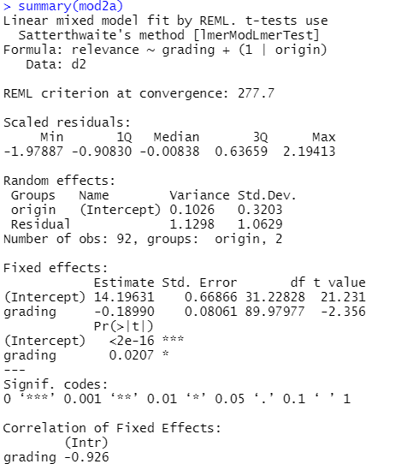
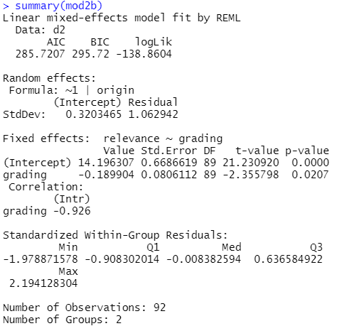


Fitting LMEs – interpreting results
lme4 package
summary(mod2a)
require(MuMIn)
r.squaredGLMM(mod2a)
nlme package
summary(mod2b)
require(MuMIn)
r.squaredGLMM(mod2b)
Variation explained by the random effect
Residual variation
Now significant!
R2m: marginal R², the variation explained by the fixed effects
R2c: conditional R², the variation explained by the fixed + random effects

Slide 25
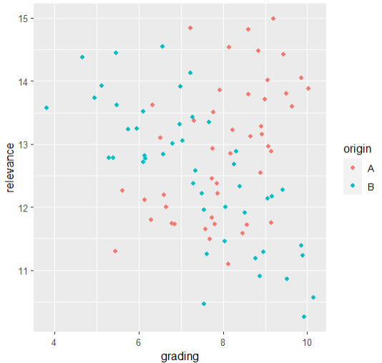
Fitting LMEs – interpreting results
Intuitively, adding <origin> as a random effect accounts for the fact that there are two different levels of <origin>: A and B
Test your understanding!: if you had fit <origin> as a fixed effect, do you think <grading> and <origin> would have a significant interaction?

Slide 26
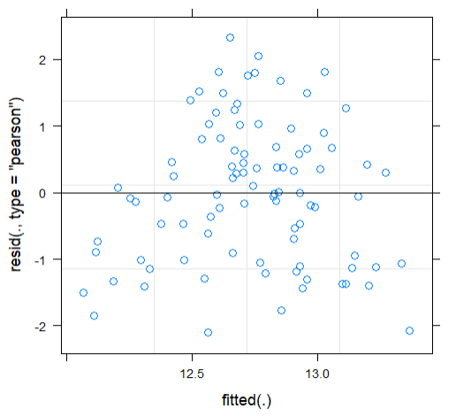
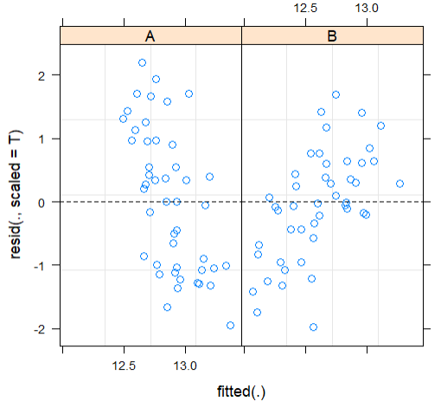
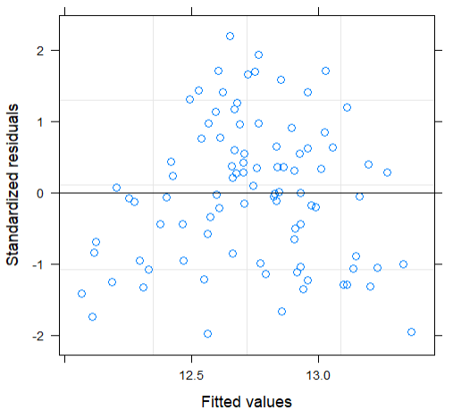
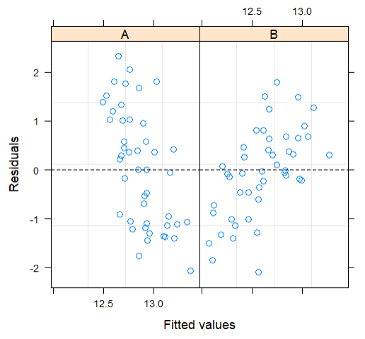
Fitting LMEs – diagnostic plots
lme4 package
#Variance for whole dataset
plot(mod2a)
require(lattice)
#Variance for levels of random effect
plot(mod2a,resid(.,scaled=T)~fitted(.)|origin,abline=0,lty=2)
nlme package
#Variance for whole dataset
plot(mod2b)
require(lattice)
#Variance for levels of random effect
plot(mod2b,resid(.,scaled=T)~fitted(.)|origin,abline=0,lty=2)

Slide 27
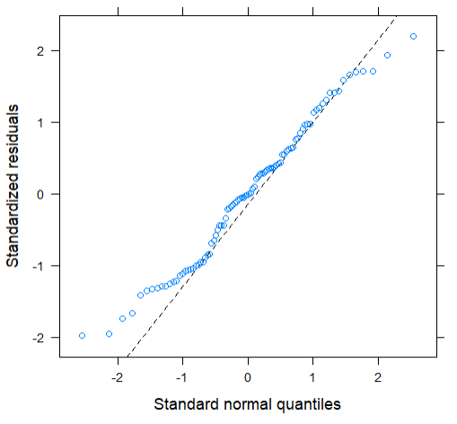
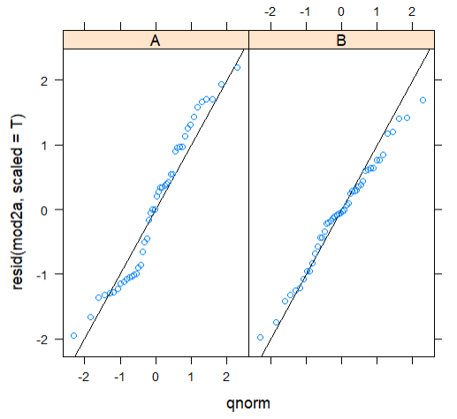
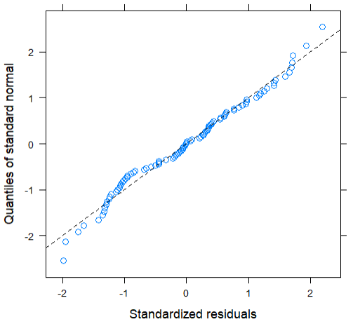
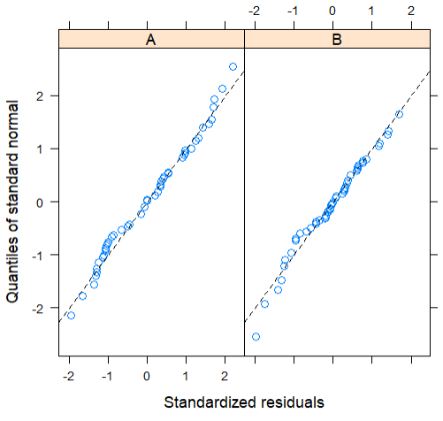
Fitting LMEs – diagnostic plots
lme4 package
#Normality for whole dataset
qqmath(mod2a,lty=2)
#Normality for levels of random effect
qqmath(~resid(mod2a,scaled=T)|origin, data=d2,abline=c(0,1))
nlme package
#Normality for whole dataset
qqnorm(mod2b,abline=c(0,1),lty=2)
#Normality for levels of random effect
qqnorm(mod2b,~resid(.,type="p")|origin,abline=c(0,1),lty=2)

Slide 28
What if heteroscedasticity is present?
Option 1: transform the y-variable.
Option 2: fit variance structures using lme() (using “weights”, similar to GLS: just add a “weights=” argument to the model).
Option 3: use GLM.
Option 1: transform the y-variable.
Option 2: use GLM.
What if residuals are non-normal?

Slide 29

Fitting LMEs – 2 nested and 2 separate random effects (categorical)
lme4 package
#Nested categorical random effects
mod3a=lmer(relevance~grading+(1|origin/process),data=d2)
summary(mod3a)
#Separate random effects
mod4a=lmer(relevance~grading+(1|origin)*(1|process),data=d2)
#Compare the two models
AIC(mod3a,mod4a)
nlme package
#Nested categorical random effects
mod3b=lme(relevance~grading,random=~1|origin/process,data=d2)
summary(mod3b)
#Separate random effects
lme() is not able to do this.
This tell tells R that <process> is nested within <origin>
Just add more variables using “+” or “*” (for interacting random effects, though this is rare)
A “boundary fit” doesn’t necessarily mean that there’s something wrong: here it is because process:origin doesn’t explain anything, so you could remove it from the model

Slide 30
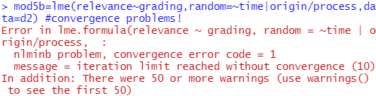
Fitting LMEs – 2 random effects (1 continuous and 1 categorical)
lme4 package
mod5a=lmer(relevance~grading+(time|origin/process),data=d2)
nlme package
mod5b=lme(relevance~grading,random=~time|origin/process,data=d2)
#Convergence problems: no results/cannot trust results!
Continuous variable goes in front of the bar: this adjusts the slope for <time> for the different levels of <origin> and <process>
Convergence problems are frustratingly common in LMEs, GLMs and GLMMs. This usually happens when your model is too complex for the package to handle. You CANNOT trust the results! You must adjust your model until there are no more convergence problems.
There are some ways you can handle this issue (I will go through these on another week):
1) Fit a simpler model (fewer explanatory variables and/or random effects);
2) Adjust some of the settings in the function;
3) Try another package;
4) Choose a different response variable.
We will take a closer look at this in a later lecture.
Note: continuous random effects are less common than categorical. If you only want to fit one continuous random effect, fit it as a fixed effect.

Slide 31
Simplifying mixed effect models
We simplify the random effects first because we don’t want them to explain any of the variation that our fixed effects can explain.
FIRST: simplify random effects—fit models using REML (Restricted Maximum Likelihood which ignores fixed effects) and compare models using AIC() .
NEXT: simplify fixed effects—fit models using ML (Maximum Likelihood) and compare models using either anova() (only if they’re subsets) or AIC() (preferred).
lme4 package
#Fitting models using REML
mod3a=lmer(relevance~grading+(1|origin/process),data=d2,REML=T)
#Fitting models using ML
mod3a=lmer(relevance~grading+(1|origin/process),data=d2,REML=F)
nlme package
#Fitting models using REML
mod3b=lme(relevance~grading,random=~1|origin/process,data=d2,method="REML")
#Fitting models using ML
mod3b=lme(relevance~grading,random=~1|origin/process,data=d2,method="ML")
REML=T is the default, so you actually don’t need to specify this
method=“REML” is the default, so you actually don’t need to specify this

Slide 32


Example – simplify random effects first
Compare models with 3 random effects structures: (i) no random effects (mod6a); (ii) <origin>; and (iii) <process> nested within <origin>.
mod6a=lm(relevance~grading+time,data=d2)
lme4 package
#Fit models using REML
mod7a1=lmer(relevance~grading+time+(1|origin),data=d2)
mod7a2=lmer(relevance~grading+time+(1|origin/process),data=d2)
#Test models using AIC()
AIC(mod6a,mod7a1,mod7a2)
nlme package
#Fit models using REML
mod7b1=lme(relevance~grading+time,random=~1|origin,data=d2)
mod7b2=lme(relevance~grading+time,random=~1|origin/process,data=d2)
#Test models using AIC()
AIC(mod6a,mod7b1,mod7b2)
In both, the model with no random effects is the best so we could choose the lm() with no random effect structure. But if we feel that including <origin> is more accurate biologically (i.e. in real life), we can choose to keep it: “the art of data analysis.”

Slide 33


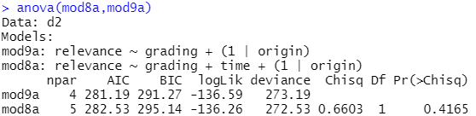

Example – simplify fixed effects after
Now we use the random effect structure we chose in the previous step, fit a new model using “ML”, and simplify using stepwise deletion.
lme4 package
#Re-fit using ML
mod8a=lmer(relevance~grading+time+(1|origin),data=d2,REML=F)
summary(mod8a) #<time> can be removed
mod9a=update(mod8a,~.-time)
summary(mod9a) #min. adequate model
#Compare using AIC() or anova()
AIC(mod8a,mod9a)
anova(mod8a,mod9a)
nlme package
#Re-fit using ML
mod8b=lme(relevance~grading+time,random=~1|origin,data=d2,method="ML")
summary(mod8b) #<time> can be removed
mod9b=update(mod8b,~.-time)
summary(mod9b) #minimum adequate model
#Compare using AIC() or anova()
AIC(mod8b,mod9b)
anova(mod8b,mod9b)
In both cases, the model without <time> is better (i.e. AIC is lower; and no difference in variation explained so we prefer the simpler model). This is our final model.

Slide 34
Summary (Learning Objectives)
Generalised Least Squares (GLS)
- Purpose
- Types of variance structures: varIdent, varFixed, varPower, varExp, varConstPower, varComb
- Fitting, checking and comparing
Linear Mixed Effect (LME) models
- Random effects: what are they, why and when to use them?
- lmer() vs. lme()
- Fitting, checking and comparing
- Simplifying: random effects using REML, then fixed effects using ML

Slide 35
Advanced analyses – Analysis decision tree
(will be modified further)
Normally distributed (errors):
Regression^*
Not normally distributed (errors):
Generalised Linear Model (GLM) with error structure to be determined by you
Start
All Continuous
Response variable type
Continuous
Explanatory variables types
All Categorical
Normally distributed (response):
Analysis of variance (ANOVA)^*
Not normally distributed (response):
Kruskal-Wallis test
Categorical
Continuous and Categorical
Time to Death
Count
Number of categories
Normally distributed (response):
Analysis of covariance (ANCOVA)^*
Not normally distributed (response):
Rank-based ANCOVA (RANCOVA) or
GLM with error structure to be determined by you
Proportion
2
>2
GLM with Poisson errors (aka Poisson regression)
No
^Heteroscedasticity: use GLS
*Random effects: use LME
Overdispersion present?
GLM with Binomial errors (aka Binary Logistic regression)
Yes
Survival Analysis
GLM with Binomial errors (aka Logistic regression)
GLM with Quasi-Poisson errors or
GLM with Negative Binomial errors
GLM with Multinomial errors (aka Multinomial Logistic regression)

